Slide 1
MODULE INSURANCE
TEAM : WEALTH WARRIORS
MODULE : INSURANCE

Slide 2
MODULE DESCRIPTION
The Insurance Management System is an essential component of any insurance company's infrastructure, designed to streamline the handling of insurance policies, customer data, claims, and related processes. It serves as a centralized platform for managing all aspects of insurance operations efficiently and effectively.
It allows for the seamless handling of insurance policies, including details such as policy ID, coverage amount, premium, policy type, and description

Slide 3
KEY FEATURES
1. List all Insurances :
This is used to easily find different types of insurance plans available.
It's like a virtual insurance catalog where one can quickly see what each plan offers.
2. Search by insurance coverage amount :
Enables users to search for coverage amount of the insurance which has been availed by a customer.
Retrieves insurance information from the database based on the provided insurance coverage amount.
3. View selected insurance :
Allows the user to view the insurance plan details based on the insurance id.
4. Purchase insurance :
Enables the user to purchase a new insurance by specifying the insurance type, name etc.

Slide 4
Search by insurance coverage amount :
Enables users to search by range of coverage amount of the insurance which has been availed by a customer.
Use of lambda expression, procedures in the implementation.
Retrieves insurance information from the database based on the provided insurance coverage amount range.

Slide 5
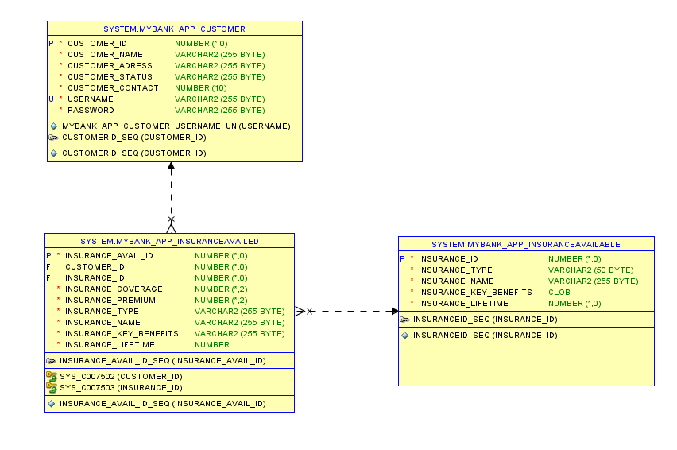
DATABASE DESIGN

Slide 6
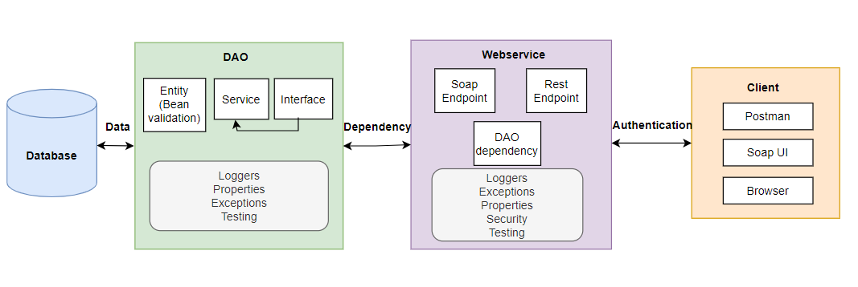
ARCHITECTURE DIAGRAM

Slide 7
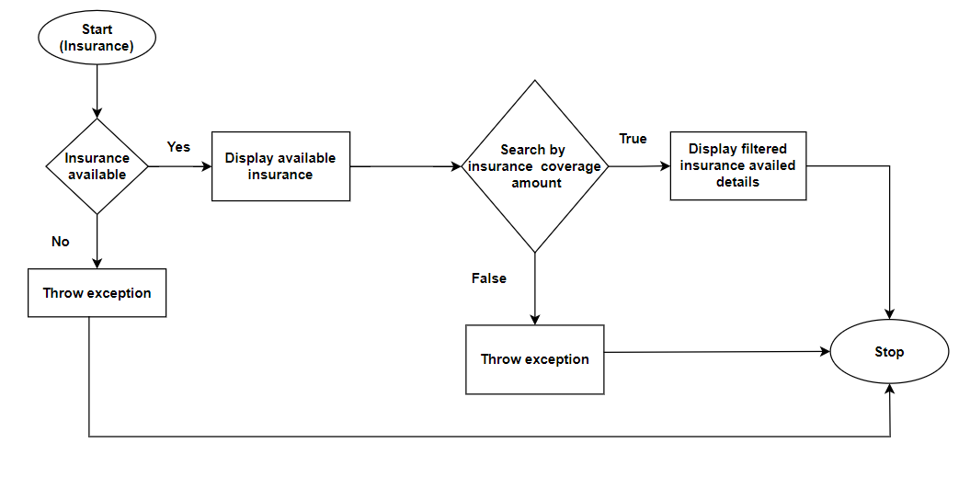
FLOW DIAGRAM

Slide 8
JAR FILE
DLTE-JavaFullStack-Divija-2024/DLTE-FinalProject/InsuranceDao/target/insurance-0.0.1-SNAPSHOT.jar at master · DivijaPat/DLTE-JavaFullStack-Divija-2024 · GitHub
DLTE-JavaFullStack-Divija-2024/DLTE-FinalProject/InsuranceWebservice/target/webservice-0.0.1-SNAPSHOT.war at master · DivijaPat/DLTE-JavaFullStack-Divija-2024 · GitHub

Slide 9
GITHUB LINK
DLTE-JavaFullStack-Divija-2024/DLTE-FinalProject at master · DivijaPat/DLTE-JavaFullStack-Divija-2024 · GitHub

Slide 10
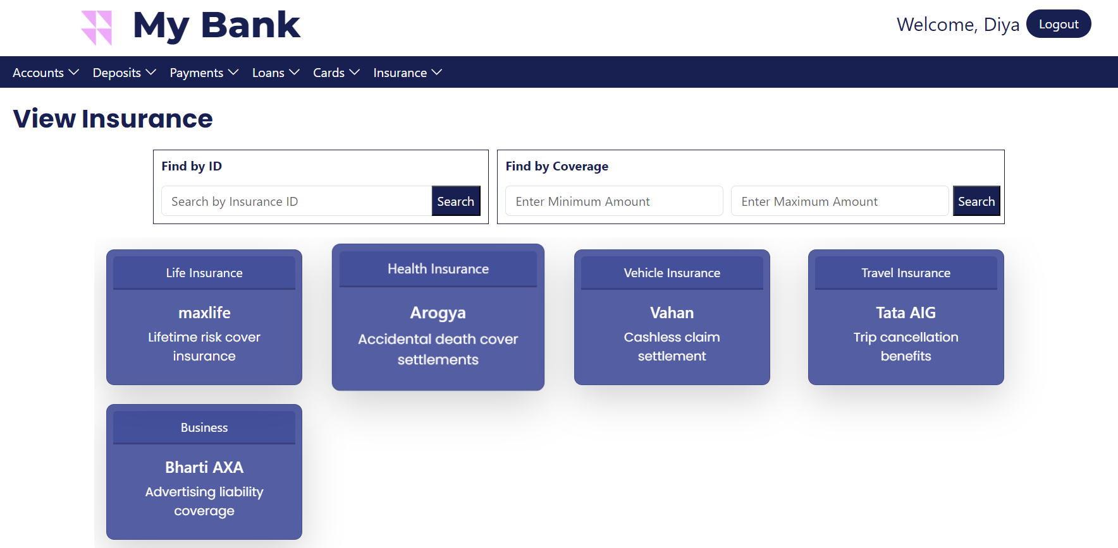
FRONTEND

Slide 11
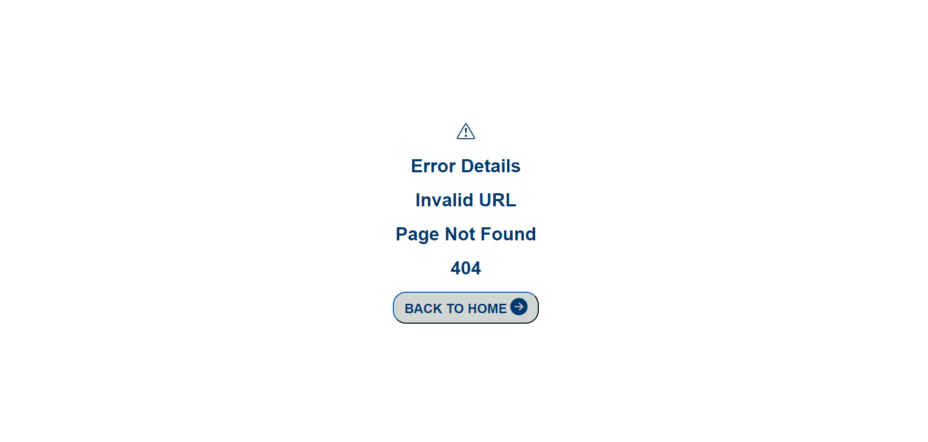
Error page

Slide 12
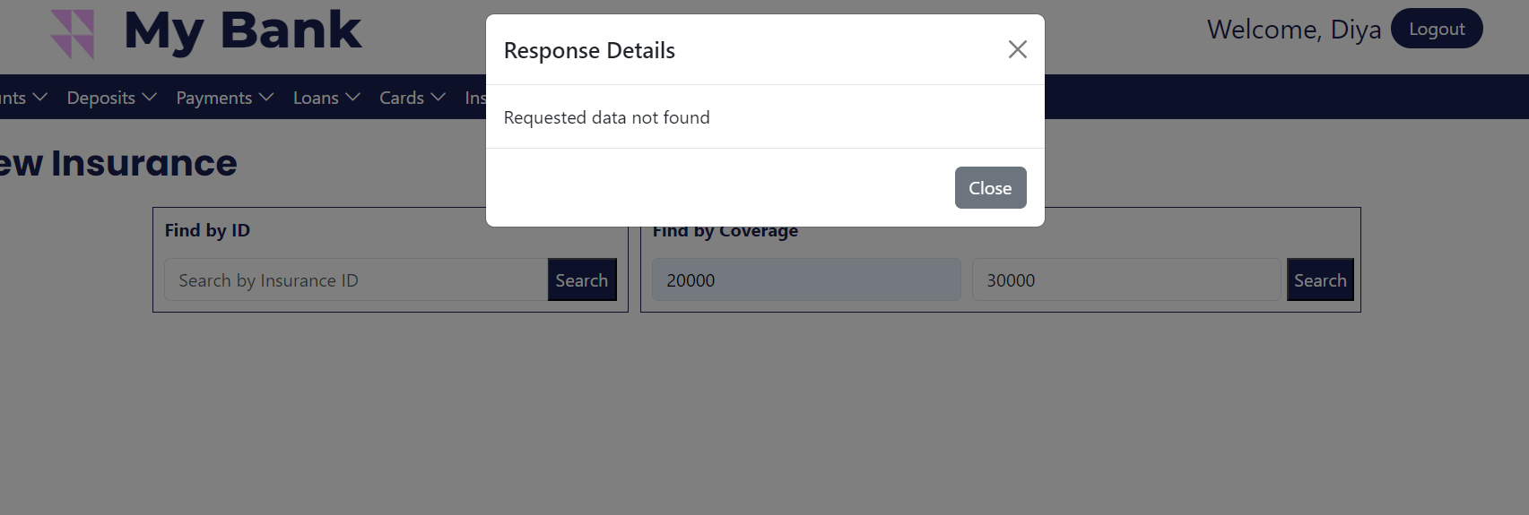
Exception handling

Slide 13
THANK YOU

